Slide 1
Introduction to quantum computing
Or Sattath
Financial Cryptography and Data Security 2022

Slide 2
Why quantum mechanics?
Quantum mechanics is the theory which best describes microscopic systems
Why should you care about the details of how microscopic systems behave? Can’t this be abstracted away?
No. Quantum mechanics fundamentally changes the notions of information and computation

Slide 3
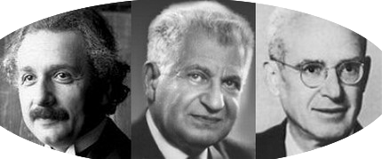
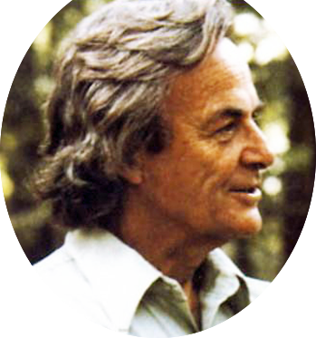
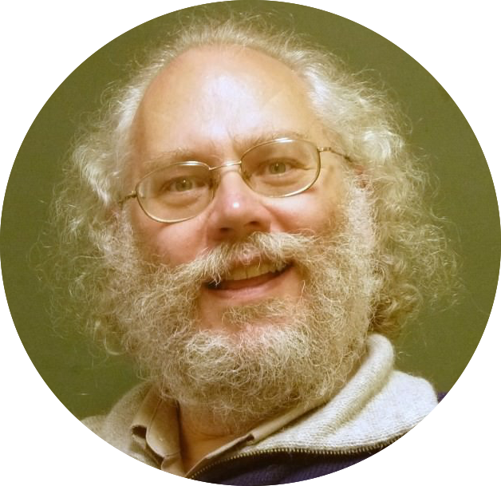
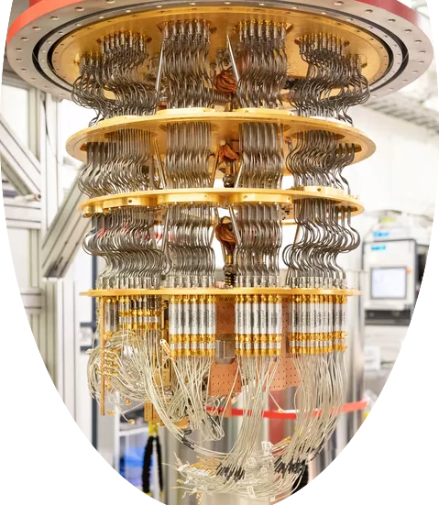
Why quantum Computing?
40-60’s: Quantum mechanics is hard to simulate on a classical computer
70’s: If it’s hard to simulate, we can use it to build a quantum computer, which (might) have more power than a classical computer.
90’s: Yes! Quantum computers can solve certain computational problems (such as Factoring and discrete log) efficiently, for which there is no (existing) classical efficient algorithm.
2020’s(?): small quantum computers are built

Slide 4
Probabilistic Bit vs. Qubit
 | Probabilistic Bit | Qubit
Description | $\left(\begin{matrix}p_{0} \\ p_{1}\end{matrix}\right)$ such that $p_{i}∈ℝ^{≥0}$, $$p_{0}+p_{1}=1$$ | $\left(\begin{matrix}a_{0} \\ a_{1}\end{matrix}\right)$ s.t. $a_{i}∈ℂ$, $${|a}_{0}{\left.​\right|}^{2}+{\left|a_{1}\right|}^{2}=1$$
Measurement outcome | $i$with probability $p_{i}$ | $i$ with probability ${\left|a_{i}\right|}^{2}$
Post-measurement | If the outcome was $i$ the vector collapses to $e_{i}$. | If the outcome was $i$ the vector collapses to $e_{i}$.
 | Probabilistic Bit | Qubit
 | Probabilistic Bit | Qubit
Description | $\left(\begin{matrix}p_{0} \\ p_{1}\end{matrix}\right)$ such that $p_{i}∈ℝ^{≥0}$, $$p_{0}+p_{1}=1$$ | $\left(\begin{matrix}a_{0} \\ a_{1}\end{matrix}\right)$ s.t. $a_{i}∈ℂ$, $${|a}_{0}{\left.​\right|}^{2}+{\left|a_{1}\right|}^{2}=1$$
Measurement outcome | $i$with probability $p_{i}$ | $i$ with probability ${\left|a_{i}\right|}^{2}$
Post-measurement | If the outcome was $i$ the vector collapses to $e_{i}$. | If the outcome was $i$ the vector collapses to $e_{i}$.
Transformations | Linear transformations which map a probabilistic bit to a probabilistic bit: $2×2$ stochastic matrices | Linear transformations which map a qubit to a qubit: $2×2$ unitary matrices.
 | Probabilistic Bit | Qubit
Description
 | Probabilistic Bit | Qubit
Description | $\left(\begin{matrix}p_{0} \\ p_{1}\end{matrix}\right)$ such that $p_{i}∈ℝ^{≥0}$, $$p_{0}+p_{1}=1$$
 | Probabilistic Bit | Qubit
Description | $\left(\begin{matrix}p_{0} \\ p_{1}\end{matrix}\right)$ such that $p_{i}∈ℝ^{≥0}$, $$p_{0}+p_{1}=1$$ | $\left(\begin{matrix}a_{0} \\ a_{1}\end{matrix}\right)$ s.t. $a_{i}∈ℂ$, $${|a}_{0}{\left.​\right|}^{2}+{\left|a_{1}\right|}^{2}=1$$
 | Probabilistic Bit | Qubit
Description | $\left(\begin{matrix}p_{0} \\ p_{1}\end{matrix}\right)$ such that $p_{i}∈ℝ^{≥0}$, $$p_{0}+p_{1}=1$$ | $\left(\begin{matrix}a_{0} \\ a_{1}\end{matrix}\right)$ s.t. $a_{i}∈ℂ$, $${|a}_{0}{\left.​\right|}^{2}+{\left|a_{1}\right|}^{2}=1$$
Measurement outcome
 | Probabilistic Bit | Qubit
Description | $\left(\begin{matrix}p_{0} \\ p_{1}\end{matrix}\right)$ such that $p_{i}∈ℝ^{≥0}$, $$p_{0}+p_{1}=1$$ | $\left(\begin{matrix}a_{0} \\ a_{1}\end{matrix}\right)$ s.t. $a_{i}∈ℂ$, $${|a}_{0}{\left.​\right|}^{2}+{\left|a_{1}\right|}^{2}=1$$
Measurement outcome | $i$with probability $p_{i}$
 | Probabilistic Bit | Qubit
Description | $\left(\begin{matrix}p_{0} \\ p_{1}\end{matrix}\right)$ such that $p_{i}∈ℝ^{≥0}$, $$p_{0}+p_{1}=1$$ | $\left(\begin{matrix}a_{0} \\ a_{1}\end{matrix}\right)$ s.t. $a_{i}∈ℂ$, $${|a}_{0}{\left.​\right|}^{2}+{\left|a_{1}\right|}^{2}=1$$
Measurement outcome | $i$with probability $p_{i}$ | $i$ with probability ${\left|a_{i}\right|}^{2}$
 | Probabilistic Bit | Qubit
Description | $\left(\begin{matrix}p_{0} \\ p_{1}\end{matrix}\right)$ such that $p_{i}∈ℝ^{≥0}$, $$p_{0}+p_{1}=1$$ | $\left(\begin{matrix}a_{0} \\ a_{1}\end{matrix}\right)$ s.t. $a_{i}∈ℂ$, $${|a}_{0}{\left.​\right|}^{2}+{\left|a_{1}\right|}^{2}=1$$
Measurement outcome | $i$with probability $p_{i}$ | $i$ with probability ${\left|a_{i}\right|}^{2}$
Post-measurement
 | Probabilistic Bit | Qubit
Description | $\left(\begin{matrix}p_{0} \\ p_{1}\end{matrix}\right)$ such that $p_{i}∈ℝ^{≥0}$, $$p_{0}+p_{1}=1$$ | $\left(\begin{matrix}a_{0} \\ a_{1}\end{matrix}\right)$ s.t. $a_{i}∈ℂ$, $${|a}_{0}{\left.​\right|}^{2}+{\left|a_{1}\right|}^{2}=1$$
Measurement outcome | $i$with probability $p_{i}$ | $i$ with probability ${\left|a_{i}\right|}^{2}$
Post-measurement | If the outcome was $i$ the vector collapses to $e_{i}$.
 | Probabilistic Bit | Qubit
Description | $\left(\begin{matrix}p_{0} \\ p_{1}\end{matrix}\right)$ such that $p_{i}∈ℝ^{≥0}$, $$p_{0}+p_{1}=1$$ | $\left(\begin{matrix}a_{0} \\ a_{1}\end{matrix}\right)$ s.t. $a_{i}∈ℂ$, $${\left|a_{0}\right|}^{2}+{\left|a_{1}\right|}^{2}=1$$
Measurement outcome | $i$with probability $p_{i}$ | $i$ with probability ${\left|a_{i}\right|}^{2}$
Post-measurement | If the outcome was $i$ the vector collapses to $e_{i}$. | If the outcome was $i$ the vector collapses to $e_{i}$.
Transformations | Linear transformations which map a probabilistic bit to a probabilistic bit: $2×2$ stochastic matrices | Linear trasnformations which map a qubit to a qubit: $2×2$ unitary matrices
 | Probabilistic Bit | Qubit
Description | $\left(\begin{matrix}p_{0} \\ p_{1}\end{matrix}\right)$ such that $p_{i}∈ℝ^{≥0}$, $$p_{0}+p_{1}=1$$ | $\left(\begin{matrix}a_{0} \\ a_{1}\end{matrix}\right)$ s.t. $a_{i}∈ℂ$, $${|a}_{0}{\left.​\right|}^{2}+{\left|a_{1}\right|}^{2}=1$$
Measurement outcome | $i$with probability $p_{i}$ | $i$ with probability ${\left|a_{i}\right|}^{2}$
Post-measurement | If the outcome was $i$ the vector collapses to $e_{i}$. | If the outcome was $i$ the vector collapses to $e_{i}$.
Transformations
Notes:
5 minutes to here.

Slide 5
Unitary matrices
Definition: 𝑈 is unitary iff $U^{−1}=U^{∗}.$
Unitaries are generalization of orthogonal (real) matrices. In the real case: rotations and reflections.
The following are equivalent:
U is unitary
U preserves the $ℓ^{2}$ norm of all vectors,
U preserves the inner product between two vectors (the inner product before multiplying by U and after multiplying both vectors by U is the same).
In most of quantum computing and cryptography, we only use real vectors and matrices.

Slide 6
Dirac’s notation
Instead of $e_{0}=\left({1 \atop 0}\right)$ and $e_{1}=\left({0 \atop 1}\right)$ we write $|0⟩$ and $|1⟩$.
For an arbitrary vector, Instead of writing $ψ$ or $\vec{ψ}$, in quantum computing we write $|ψ⟩$. This is called a “ket”.
A qubit can always be written as $\left|ψ\right\rangle =\sum_{i∈\{0,1\}}{a_{i}|i⟩}$.
The convention is to use Latin letters for bit-strings, Greek letters in a ket for general states.
We define $⟨ψ|≡{\left|ψ\right\rangle }^{∗}$.
Test yourself: what is $\left|α\right\rangle \left\langle β\right|$? A scalar / vector / matrix?
Answer: $\left|α\right\rangle \left\langle β\right|$ is a (rank-1) matrix.

Slide 7
Important states and unitaries
$X=\left(\begin{matrix}0 & 1 \\ 1 & 0\end{matrix}\right), X\left|0\right\rangle =\left|1\right\rangle ,X\left|1\right\rangle =\left|0\right\rangle .$
$|+⟩≡\frac{1}{\sqrt{2}}(|0⟩+|1⟩ )$, $\left|−\right\rangle ≡\frac{1}{\sqrt{2}}(|0⟩−|1⟩ )$
$Z=\left(\begin{matrix}1 & 0 \\ 0 & −1\end{matrix}\right), Z\left|+\right\rangle =\left|−\right\rangle , Z\left|−\right\rangle =|+⟩$.
$H=\frac{1}{√2}\left(\begin{matrix}1 & 1 \\ 1 & −1\end{matrix}\right), H\left|0\right\rangle =\left|+\right\rangle ,H\left|1\right\rangle =|−⟩$.
$R_{θ}=\left(\begin{matrix}\cos{θ} & −\sin{θ} \\ \sin{θ} & \cos{θ}\end{matrix}\right), R_{π/4}\left|0\right\rangle =\left|+\right\rangle ,R_{π/4}\left|+\right\rangle =|1⟩$
Notes:
12 minutes to here.

Slide 8
Toy examples:
What happens when $\left|+\right\rangle$ is measured? For $\left|−\right\rangle$?
Both cases: the outcome is 0/1 with %50.
So, are they “the same” state? (Hint: Can you distinguish between them? If so, how?)
No! $|+⟩$ and $|−⟩$ can be distinguished by applying $H$, and then measuring (the outcome “0” means the state was $|0⟩$ and the outcome 1 means the state was $|1⟩)$.
This procedure is also called “measurement in the +/- basis”, whereas the standard measurement is in the standard basis.
Notes:
Measurement in another basis in the next slide.

Slide 9
Measurements in another basis
Measuring the state $\left|ψ\right\rangle = \sum_{i∈\{0,1\}}{a_{i}}|i⟩$ yields the outcome $i$ with probability ${|a}_{i}{\left.​\right|}^{2}={\left|\left\langle ψ | i\right\rangle \right|}^{2}.$ We call this a measurement in the standard basis.
We can measure in any orthonormal basis ${\left\{|α_{i}⟩\right\}}_{i}$.
The measurement outcome is $i$ with probability ${\left|\left\langle ψ | α_{i}\right\rangle \right|}^{2}$.

Slide 10
2 Probabilistic Bits vs. 2 Qubits
 | 2 Bits | Qubit
Description

Slide 11
2 Probabilistic Bits vs. 2 Qubits
 | 2 Bits | Qubit
Description | $\left(\begin{aligned}\begin{aligned}\begin{matrix}p_{00} \\ p_{01}\end{matrix} \\ p_{10}\end{aligned} \\ p_{11}\end{aligned}\right)∈ℝ^{2}⊗ℝ^{2}$ , $\sum_{x∈{\left\{0,1\right\}}^{2}}{p_{x}}=1, p_{x}≥0$

Slide 12
2 Probabilistic Bits vs. 2 Qubits
 | 2 Bits | Qubit
Description | $\left(\begin{aligned}\begin{aligned}\begin{matrix}p_{00} \\ p_{01}\end{matrix} \\ p_{10}\end{aligned} \\ p_{11}\end{aligned}\right)∈ℝ^{2}⊗ℝ^{2}$ , $\sum_{x∈{\left\{0,1\right\}}^{2}}{p_{x}}=1, p_{x}≥0$ | $\left(\begin{aligned}\begin{aligned}\begin{matrix}a_{00} \\ a_{01}\end{matrix} \\ a_{10}\end{aligned} \\ a_{11}\end{aligned}\right)∈ℂ^{2}⊗ℂ^{2}$, $\sum_{x∈{\left\{0,1\right\}}^{2}}{{|a}_{x}{\left.​\right|}^{2}}=1$

Slide 13
2 Probabilistic Bits vs. 2 Qubits
 | 2 Bits | Qubit
Description | $\left(\begin{aligned}\begin{aligned}\begin{matrix}p_{00} \\ p_{01}\end{matrix} \\ p_{10}\end{aligned} \\ p_{11}\end{aligned}\right)∈ℝ^{2}⊗ℝ^{2}$ , $\sum_{x∈{\left\{0,1\right\}}^{2}}{p_{x}}=1, p_{x}≥0$ | $\left(\begin{aligned}\begin{aligned}\begin{matrix}a_{00} \\ a_{01}\end{matrix} \\ a_{10}\end{aligned} \\ a_{11}\end{aligned}\right)∈ℂ^{2}⊗ℂ^{2}$, $\sum_{x∈{\left\{0,1\right\}}^{2}}{{|a}_{x}{\left.​\right|}^{2}}=1$
Measurement outcome for m.s.b.

Slide 14
2 Probabilistic Bits vs. 2 Qubits
 | 2 Bits | Qubit
Description | $\left(\begin{aligned}\begin{aligned}\begin{matrix}p_{00} \\ p_{01}\end{matrix} \\ p_{10}\end{aligned} \\ p_{11}\end{aligned}\right)∈ℝ^{2}⊗ℝ^{2}$ , $\sum_{x∈{\left\{0,1\right\}}^{2}}{p_{x}}=1, p_{x}≥0$ | $\left(\begin{aligned}\begin{aligned}\begin{matrix}a_{00} \\ a_{01}\end{matrix} \\ a_{10}\end{aligned} \\ a_{11}\end{aligned}\right)∈ℂ^{2}⊗ℂ^{2}$, $\sum_{x∈{\left\{0,1\right\}}^{2}}{{|a}_{x}{\left.​\right|}^{2}}=1$
Measurement outcome for m.s.b. | $0$with probability $p_{00}+p_{01}$

Slide 15
2 Probabilistic Bits vs. 2 Qubits
 | 2 Bits | Qubit
Description | $\left(\begin{aligned}\begin{aligned}\begin{matrix}p_{00} \\ p_{01}\end{matrix} \\ p_{10}\end{aligned} \\ p_{11}\end{aligned}\right)∈ℝ^{2}⊗ℝ^{2}$ , $\sum_{x∈{\left\{0,1\right\}}^{2}}{p_{x}}=1, p_{x}≥0$ | $\left(\begin{aligned}\begin{aligned}\begin{matrix}a_{00} \\ a_{01}\end{matrix} \\ a_{10}\end{aligned} \\ a_{11}\end{aligned}\right)∈ℂ^{2}⊗ℂ^{2}$, $\sum_{x∈{\left\{0,1\right\}}^{2}}{{|a}_{x}{\left.​\right|}^{2}}=1$
Measurement outcome for m.s.b. | $0$with probability $p_{00}+p_{01}$ | 0 with probability ${\left|a_{00}\right|}^{2}+{\left|a_{01}\right|}^{2}$

Slide 16
2 Probabilistic Bits vs. 2 Qubits
 | 2 Bits | Qubit
Description | $\left(\begin{aligned}\begin{aligned}\begin{matrix}p_{00} \\ p_{01}\end{matrix} \\ p_{10}\end{aligned} \\ p_{11}\end{aligned}\right)∈ℝ^{2}⊗ℝ^{2}$ , $\sum_{x∈{\left\{0,1\right\}}^{2}}{p_{x}}=1, p_{x}≥0$ | $\left(\begin{aligned}\begin{aligned}\begin{matrix}a_{00} \\ a_{01}\end{matrix} \\ a_{10}\end{aligned} \\ a_{11}\end{aligned}\right)∈ℂ^{2}⊗ℂ^{2}$, $\sum_{x∈{\left\{0,1\right\}}^{2}}{{|a}_{x}{\left.​\right|}^{2}}=1$
Measurement outcome for m.s.b. | $0$with probability $p_{00}+p_{01}$ | 0 with probability ${\left|a_{00}\right|}^{2}+{\left|a_{01}\right|}^{2}$
Post-measurement state for outcome 0

Slide 17
2 Probabilistic Bits vs. 2 Qubits
 | 2 Bits | Qubit
Description | $\left(\begin{aligned}\begin{aligned}\begin{matrix}p_{00} \\ p_{01}\end{matrix} \\ p_{10}\end{aligned} \\ p_{11}\end{aligned}\right)∈ℝ^{2}⊗ℝ^{2}$ , $\sum_{x∈{\left\{0,1\right\}}^{2}}{p_{x}}=1, p_{x}≥0$ | $\left(\begin{aligned}\begin{aligned}\begin{matrix}a_{00} \\ a_{01}\end{matrix} \\ a_{10}\end{aligned} \\ a_{11}\end{aligned}\right)∈ℂ^{2}⊗ℂ^{2}$, $\sum_{x∈{\left\{0,1\right\}}^{2}}{{|a}_{x}{\left.​\right|}^{2}}=1$
Measurement outcome for m.s.b. | $0$with probability $p_{00}+p_{01}$ | 0 with probability ${\left|a_{00}\right|}^{2}+{\left|a_{01}\right|}^{2}$
Post-measurement state for outcome 0 | Collapses to $\frac{1}{p_{00}+p_{01}}\left(\begin{aligned}\begin{aligned}\begin{matrix}p_{00} \\ p_{01}\end{matrix} \\ 0\end{aligned} \\ 0\end{aligned}\right)$

Slide 18
2 Probabilistic Bits vs. 2 Qubits
 | 2 Bits | Qubit
Description | $\left(\begin{aligned}\begin{aligned}\begin{matrix}p_{00} \\ p_{01}\end{matrix} \\ p_{10}\end{aligned} \\ p_{11}\end{aligned}\right)∈ℝ^{2}⊗ℝ^{2}$ , $\sum_{x∈{\left\{0,1\right\}}^{2}}{p_{x}}=1, p_{x}≥0$ | $\left(\begin{aligned}\begin{aligned}\begin{matrix}a_{00} \\ a_{01}\end{matrix} \\ a_{10}\end{aligned} \\ a_{11}\end{aligned}\right)∈ℂ^{2}⊗ℂ^{2}$, $\sum_{x∈{\left\{0,1\right\}}^{2}}{{|a}_{x}{\left.​\right|}^{2}}=1$
Measurement outcome for m.s.b. | $0$with probability $p_{00}+p_{01}$ | 0 with probability ${\left|a_{00}\right|}^{2}+{\left|a_{01}\right|}^{2}$
Post-measurement state for outcome 0 | Collapses to $\frac{1}{p_{00}+p_{01}}\left(\begin{aligned}\begin{aligned}\begin{matrix}p_{00} \\ p_{01}\end{matrix} \\ 0\end{aligned} \\ 0\end{aligned}\right)$ | Collapses to $\frac{1}{\sqrt{{\left|a_{00}\right|}^{2}+{\left|a_{01}\right|}^{2}}}\left(\begin{aligned}\begin{aligned}\begin{matrix}a_{00} \\ a_{01}\end{matrix} \\ 0\end{aligned} \\ 0\end{aligned}\right)$

Slide 19
2 Probabilistic Bits vs. 2 Qubits
 | 2 Bits | Qubit
Description | $\left(\begin{aligned}\begin{aligned}\begin{matrix}p_{00} \\ p_{01}\end{matrix} \\ p_{10}\end{aligned} \\ p_{11}\end{aligned}\right)∈ℝ^{2}⊗ℝ^{2}$ , $\sum_{x∈{\left\{0,1\right\}}^{2}}{p_{x}}=1, p_{x}≥0$ | $\left(\begin{aligned}\begin{aligned}\begin{matrix}a_{00} \\ a_{01}\end{matrix} \\ a_{10}\end{aligned} \\ a_{11}\end{aligned}\right)∈ℂ^{2}⊗ℂ^{2}$, $\sum_{x∈{\left\{0,1\right\}}^{2}}{{|a}_{x}{\left.​\right|}^{2}}=1$
Measurement outcome for m.s.b. | $0$with probability $p_{00}+p_{01}$ | 0 with probability ${\left|a_{00}\right|}^{2}+{\left|a_{01}\right|}^{2}$
Post-measurement state for outcome 0 | Collapses to $\frac{1}{p_{00}+p_{01}}\left(\begin{aligned}\begin{aligned}\begin{matrix}p_{00} \\ p_{01}\end{matrix} \\ 0\end{aligned} \\ 0\end{aligned}\right)$ | Collapses to $\frac{1}{\sqrt{{\left|a_{00}\right|}^{2}+{\left|a_{01}\right|}^{2}}}\left(\begin{aligned}\begin{aligned}\begin{matrix}a_{00} \\ a_{01}\end{matrix} \\ 0\end{aligned} \\ 0\end{aligned}\right)$
Transformations

Slide 20
2 Probabilistic Bits vs. 2 Qubits
 | 2 Bits | Qubit
Description | $\left(\begin{aligned}\begin{aligned}\begin{matrix}p_{00} \\ p_{01}\end{matrix} \\ p_{10}\end{aligned} \\ p_{11}\end{aligned}\right)∈ℝ^{2}⊗ℝ^{2}$ , $\sum_{x∈{\left\{0,1\right\}}^{2}}{p_{x}}=1, p_{x}≥0$ | $\left(\begin{aligned}\begin{aligned}\begin{matrix}a_{00} \\ a_{01}\end{matrix} \\ a_{10}\end{aligned} \\ a_{11}\end{aligned}\right)∈ℂ^{2}⊗ℂ^{2}$, $\sum_{x∈{\left\{0,1\right\}}^{2}}{{|a}_{x}{\left.​\right|}^{2}}=1$
Measurement outcome for m.s.b. | $0$with probability $p_{00}+p_{01}$ | 0 with probability ${\left|a_{00}\right|}^{2}+{\left|a_{01}\right|}^{2}$
Post-measurement state for outcome 0 | Collapses to $\frac{1}{p_{00}+p_{01}}\left(\begin{aligned}\begin{aligned}\begin{matrix}p_{00} \\ p_{01}\end{matrix} \\ 0\end{aligned} \\ 0\end{aligned}\right)$ | Collapses to $\frac{1}{\sqrt{{\left|a_{00}\right|}^{2}+{\left|a_{01}\right|}^{2}}}\left(\begin{aligned}\begin{aligned}\begin{matrix}a_{00} \\ a_{01}\end{matrix} \\ 0\end{aligned} \\ 0\end{aligned}\right)$
Transformations | Linear transformations which map distributions to distributions: $4×4$ stochastic matrices

Slide 21
2 Probabilistic Bits vs. 2 Qubits
 | 2 Bits | Qubit
Description | $\left(\begin{aligned}\begin{aligned}\begin{matrix}p_{00} \\ p_{01}\end{matrix} \\ p_{10}\end{aligned} \\ p_{11}\end{aligned}\right)∈ℝ^{2}⊗ℝ^{2}$ , $\sum_{x∈{\left\{0,1\right\}}^{2}}{p_{x}}=1, p_{x}≥0$ | $\left(\begin{aligned}\begin{aligned}\begin{matrix}a_{00} \\ a_{01}\end{matrix} \\ a_{10}\end{aligned} \\ a_{11}\end{aligned}\right)∈ℂ^{2}⊗ℂ^{2}$, $\sum_{x∈{\left\{0,1\right\}}^{2}}{{|a}_{x}{\left.​\right|}^{2}}=1$
Measurement outcome for m.s.b. | $0$with probability $p_{00}+p_{01}$ | 0 with probability ${\left|a_{00}\right|}^{2}+{\left|a_{01}\right|}^{2}$
Post-measurement state for outcome 0 | Collapses to $\frac{1}{p_{00}+p_{01}}\left(\begin{aligned}\begin{aligned}\begin{matrix}p_{00} \\ p_{01}\end{matrix} \\ 0\end{aligned} \\ 0\end{aligned}\right)$ | Collapses to $\frac{1}{\sqrt{{\left|a_{00}\right|}^{2}+{\left|a_{01}\right|}^{2}}}\left(\begin{aligned}\begin{aligned}\begin{matrix}a_{00} \\ a_{01}\end{matrix} \\ 0\end{aligned} \\ 0\end{aligned}\right)$
Transformations | Linear transformations which map distributions to distributions: $4×4$ stochastic matrices | Linear transformations which map 2 qubits to 2 qubits: $4×$4 unitary matrices.

Slide 22
Tensor products
Instead of thinking of 2 qubits as a vector in $ℂ^{4}$, we can think of them as vectors in $ℂ^{2}⊗ℂ^{2}$.
$\{\left|0\right\rangle ⊗\left|0\right\rangle ,\left|0\right\rangle ⊗\left|1\right\rangle ,\left|1\right\rangle ⊗\left|0\right\rangle ,\left|1\right\rangle ⊗\left|1\right\rangle \}$ form the orthogonal standard basis of $ℂ^{2}⊗ℂ^{2}$.
States of the form $\left|α\right\rangle ⊗\left|β\right\rangle$ are called tensor product states.
$\frac{1}{2}(\left|0\right\rangle ⊗\left|0\right\rangle +\left|0\right\rangle ⊗\left|1\right\rangle +\left|1\right\rangle ⊗\left|0\right\rangle +\left|1\right\rangle ⊗\left|1\right\rangle )=\left|+\right\rangle ⊗\left|+\right\rangle$, and therefore is a tensor product state.
States which are not tensor products are called entangled states.

Slide 23
Cheat-sheet for tensor products
Distributive: $\left|α\right\rangle ⊗\left( |β\right\rangle +\left|γ\right\rangle )=|α⟩⊗|β⟩+|α⟩⊗|γ⟩$
$\left(A⊗B\right)\left|α\right\rangle ⊗\left|β\right\rangle =\left(A\left|α\right\rangle \right)⊗(B\left|β\right\rangle )$
For vectors: $u⊗v=\left(\begin{matrix}u_{0}v \\ ⋮ \\ u_{n}v\end{matrix}\right)$.
More generally, $A⊗B=\left(\left[\begin{matrix}a_{00}B & ⋯ & a_{m,0}B \\ ⋮ & ⋱ & ⋮ \\ a_{0,n}B & ⋯ & a_{n,m}B\end{matrix}\right]\right)$

Slide 24
Entangled states
Consider the state $\left|Φ^{+}\right\rangle ≡\frac{1}{\sqrt{2}}(|0⟩⊗|0⟩+|1⟩⊗|1⟩ )$.
This is not a tensor product state (try to prove later!)

Slide 25
No-Cloning Theorem
Can arbitrary quantum states be copied?
No!
Theorem: The transformation $T(|ψ⟩⊗|0⟩)=|ψ⟩⊗|ψ⟩$ is not even linear, and therefore is not allowed in quantum mechanics.
Proof: Suppose $∃$linear $U$ such that $U(|ψ⟩⊗|0⟩)=|ψ⟩⊗|ψ⟩,$for every $1$-qubit state$|ψ⟩$.
$U(|0⟩|0⟩)=|0⟩|0⟩$, (1)
$U(|1⟩|0⟩)=|1⟩|1⟩$. (2)
$U(|+⟩|0⟩)=|+⟩|1⟩$. (3)
Adding (1) and (2) and normalizing, $U(|+⟩|0⟩)=\frac{1}{\sqrt{2}}(|0⟩|0⟩+|1⟩|1⟩)$.
$≠|+⟩|+⟩$.
Contradicting (3).

Slide 26
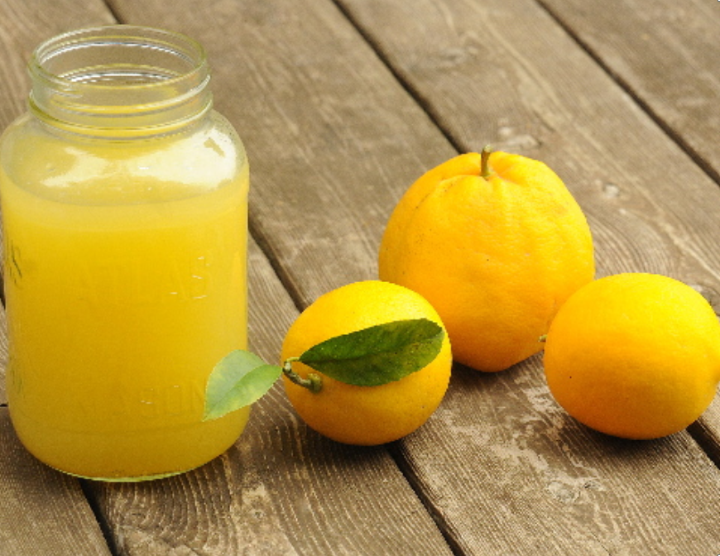
Crypgography
Hard problems
Secure protocols
No cloning
Irreversible Measurements
Non-local games

Slide 27
Quantum Algorithms

Slide 28
Shor’s Factoring Algorithm [Shor’94]
Problem: Given a $d$-bit integer $N=p_{1}p_{2}$ where $p_{1}$ and $p_{2}$ are primes, find the prime factors?
Naïve (Classical) Algorithm: Brute force for all primes in $\left[√N\right].$
Complexity: $Ω(\exp\left(d\right))$
Best Classical Algorithm known (Number-field Sieves) : $Ω(exp⁡(d^{1/3})).$
Shor’s Factoring Algorithm: $O(d^{3})$.
Conclusion: Factoring which is believed not to be in $BPP,$ is in $BQP$.

Slide 29
Shor’s Discrete Logarithm Algorithm [Shor’94,Boneh-Lipton’95]
Problem: Let $G$ be a group of order $N$. Given an element $g∈G$, and $g^{x}∈G$ for some natural number $x.$Find $x$.
Naïve (Classical) Algorithm: Brute force for possible numbers in $\left[N\right].$
Complexity: $Ω(N)$
Best Classical Algorithm known (Baby-step Giant-step algorithm) : $Ω(N^{1/2}).$
Shor’s Factoring Algorithm: $O({log⁡(N)}^{2})$.
Conclusion: Discrete Logarithm which is believed not to be in $BPP,$ is in $BQP$.

Slide 30
Implications of Shor’s Algorithms
Shor’s algorithms totally breaks almost all the public key cryptography used in practice
Total break: Adversary can recover the secret key only from the public key.
Examples:
Encryption/key-exchange: Diffie-Hellman, ElGamal, RSA, Goldwasser-Micali
Digital signatures: RSA signatures, DSA signatures, and ECDSA signatures.
Most of minicrypt (PRG, PRF, symmetric encryption, hash-functions, MACs) is uneffected. Some interesting exceptions (Even-Mansour cipher, 3-round Feistel networks)
NIST PQ cryptography: finalists for post-quantum signatures and key-exchange (KEMs).
Notes:
One of the finalists (rainbow) has recently been succeffully broken (classical attack).

Slide 31
Exact Complexity of Quantum Attack vs Classical Bits of Security for ECDSA
Classical bits of security | Modular size required | Logical Qubits required | Physical Qubits needed to break in 24 hours
128 | 256 | 2330 | $${10}^{7}$$
192 | 384 | 3484 | $$1.56 × {10}^{7}$$
Current technology
Error correcting code: Surface code with cycle of 5 MHz
Base noise of physical qubits: ${10}^{−3}$ errors per measurement
Source:
[Aggarwal et al.’17], https://research.kudelskisecurity.com/2021/08/24/quantum-attack-resource-estimate-using-shors-algorithm-to-break-rsa-vs-dh-dsa-vs-ecc/
Bitcoin and Ethereum uses ECDSA-256
Notes:
Using superconducting qubits

Slide 32
Predictions [Aggarwal et al.’17]
When can quantum computing break ECDSA in reasonable time (10 minutes)?
Educated estimates: After 2027, and before 2040.

Slide 33
Grover’s unordered search algorithm

Slide 34
Grover’s Quantum Search Problem
Problem Statement: Given a black-box access to an array of $N$items with one of them marked and others not, find the marked item.
Best Classical Algorithm: Brute force. Complexity $Ω(N)$.
Probability of success after $t$ iterations= $\frac{t}{N}$.
Grover’s Search: $Θ(√N)$.
Probability of success after $t$ iterations $∝\frac{t^{2}}{N}$.
The number of iterations, $t$ doesn’t need to be chosen in advance!
Conclusion: Grover’s Search gives quadratic speedup even on premature stop.

Slide 35
Grover’s search
$$|y〉$$
$$θ$$
$$|init〉=\frac{1}{√N}\sum_{x∈S}{|x⟩}$$
$$φ$$
$$|y^{⊥}〉$$
$$φ≈sin\left(φ\right)=cos\left(θ\right)=\frac{1}{\sqrt{N}}.$$

Slide 36
Grover’s search
Main Ingredients:
$U_{y^{⊥}}≡Id−2|y⟩⟨y|$
Reflection around $|y^{⊥}⟩.$
$U_{init}≡2|init⟩⟨init|−Id$
Reflection around initial state $|init〉$
$$O_{y}(x)=\left\{\begin{aligned}1 x=y \\ 0 otherwise\end{aligned}\right.$$
$$|y〉$$
Initial state: $|init〉=\frac{1}{√N}\sum_{x∈S}{|x⟩}$
$$|ψ〉$$
$$θ$$
$$|init〉$$
$$θ$$
$$θ$$
$$|y^{⊥}〉$$
$$θ$$

Slide 37
Grover’s search (Algorithm)
Initial state : $|init〉=\frac{1}{√N}\sum_{x∈S}{|x⟩}$
Repeat $T$ times:
Apply $U_{y^{⊥}}$.
Apply $U_{init}$.
Measure the state and output the outcome.
$$|y〉$$
We will decide later
$${\left(U_{init}U_{y^{⊥}}\right)}^{2}|init〉$$
Rotation by $2φ$
$$5φ=φ_{2}$$
$θ_{n}$: Angle after $t$ iteration
$$U_{init}U_{y^{⊥}}|init〉$$
$$=φ_{1}$$
$$θ$$
$$3φ$$
$$|init〉=\frac{1}{√N}\sum_{x∈S}{|x⟩}$$
$$2φ$$
$φ_{1}=3φ,$Measuring now yields $y$
with probability $\sin^{2}\left(φ_{1}\right)=\sin^{2}{(3φ)}$
$$φ$$
$$2φ$$
$$|y^{⊥}〉$$
$$φ$$
$$U_{y^{⊥}}|init〉$$
$$3φ$$
$φ_{2}=5φ,$
Measuring now yields $y$ with probability $\sin^{2}\left(5φ\right)$
$$U_{y^{⊥}} U_{init}U_{y^{⊥}}|init〉$$

Slide 38
Grover’s search (Algorithm)
Initial state : $|init〉=\frac{1}{√N}\sum_{x∈S}{|x⟩}$
Repeat $T$ times:
Apply $U_{y^{⊥}}$.
Apply $U_{init}$.
Measure the state and output the outcome.
$$|y〉$$
We will decide later
$${\left(U_{init}U_{y^{⊥}}\right)}^{2}|init〉$$
$$5φ=φ_{2}$$
$φ_{n}$: Angle after $t$ iterations
$$U_{init}U_{y^{⊥}}|init〉$$
$$=φ_{1}$$
$$θ$$
$$3φ$$
$$|init〉=\frac{1}{√N}\sum_{x∈S}{|x⟩}$$
$$2φ$$
$$φ_{t}=\left(2t+1\right)φ≈\frac{2t}{\sqrt{N}}$$
$$φ$$
$$2φ$$
$$|y^{⊥}〉$$
$$φ$$
$$U_{y^{⊥}}|init〉$$
$$3φ$$
$$U_{y^{⊥}} U_{init}U_{y^{⊥}}|init〉$$
# iterations = $T∝\frac{1}{φ}≈\sqrt{N}$.

Slide 39
Conclusion
Grover’s algorithm achieves a quadratic speedup. [For large N]
We can stop the algorithm prematurely, and still get a quadratic advantage! After $t$ iterations, the success probability is $≈\frac{t^{2}}{N}$. [for $t^{2}≪N$]
The number of iterations doesn’t need to be chosen in advance!
$$|y〉$$
$${\left(U_{r}U_{f}\right)}^{t}|init〉$$
$${\left(U_{r}U_{f}\right)}^{2}|init〉$$
$${U_{r}U}_{f}|init〉$$
$$(2t+1)φ$$
$$|init〉$$
$$φ$$
$$|y^{⊥}〉$$
$$φ$$
$$U_{f}|init〉$$
$$\cos\left(φ\right)=\frac{1}{\sqrt{N}}.$$

Slide 40
Grover’s Quantum Search Problem with k-marked items
Problem Statement: Given a black-box access to an array of $N$items with $k$ of them marked and some not, find a marked item.
Best Classical Algorithm: Brute force. Complexity $Θ(\frac{N}{K})$.
Probability of success after $t$ iterations= $\frac{tk}{N}$.
Grover’s Search: $Θ(\sqrt{\frac{N}{K}})$.
Probability of success after $t$ iterations $∝\frac{t^{2}K}{N}$.
The number of iterations, $t$ doesn’t need to be chosen in advance!
Conclusion: Grover’s Search gives quadratic speedup even on premature stop.

Slide 41
Implication for Quantum Mining
Classical World
Quantum World
Game theoretic equilibrium
Grover’s Search
Quadratic Speedup
Quantum miner can prematurely stop Grover’s search to increase probability of success.
Will lead to increase in fork-rate of blockchains.
To be continued in the next talk….

Slide 42
Thank you!

